Slide 1


A L E S I A
ALESIA KUCHARENKA
June 2025

Slide 2

Outline
Executive Summary
Introduction
Methodology
Results
Conclusion
Appendix
A L E S I A

Slide 3

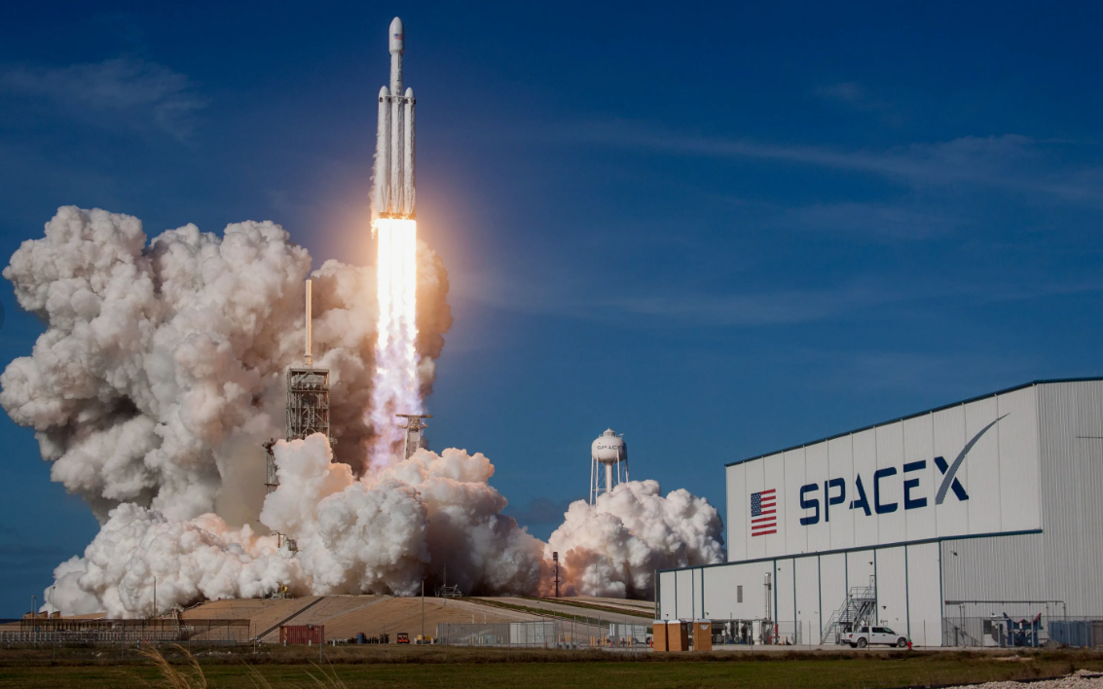
Executive Summary
Today is the most successful company in the field of commercial space.
What allows it to be so?
Summary of methodologies
collecting relevant data from various sources
improving the quality by performing data wrangling
exploring the processed data
applying some basic statistical analysis
data visualization
training a machine learning model to predict the result
A L E S I A
Summary of all results
All launch sites are in very close proximity to the ocean coast and to the Equator line, railways, highways and coastline and keep certain distance away from cities. The total number of successful mission outcomes significantly exceed the number of failure missions. KSC LC-39A launch site, rocket configuration Falcon 9 FT and payload mass between 2000 and 4000 kg have the highest success rate. The first stage often returns successfully with more massive payloads, as the flight number increases, with heavy payloads are more for Polar, LEO and ISS. Types of orbits ES-L1, GEO, HEO and SSO have the highest success rates. All predictive models have the same classification accuracy.
Notes:
you need to collect data, as much and relevant as possible.
You will be collecting data from various sources. After your raw data has been collected, you will need to improve the quality by performing data wrangling.
Then you can start exploring the processed data. We will be your guide as we explore some really interesting real-world datasets together. You'll get to practice your SQL skills as we query the data and gather insights.
You'll gain further insights into the data by applying some basic statistical analysis and data visualization, you'll be able to see directly how variables might be related to each other.
We'll drill down into finer levels of detail by splitting the data into groups defined by categorical variables or factors in your data.
You will be guided to build, evaluate, and refine predictive models for discovering more exciting insights.
The final task of this capstone project is to create a presentation that will be developed into stories of all your analysis.

Slide 4
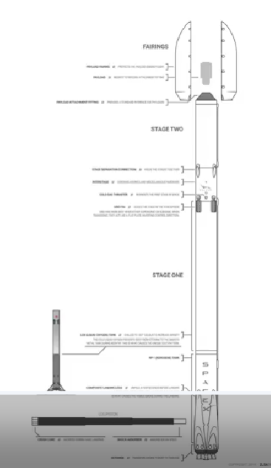
Introduction
What is the reason for success?
One reason SpaceX can do this is the rocket launches are relatively inexpensive. Unlike other rocket providers, SpaceX's Falcon 9 can recover the first stage.
A L E S I A
This stage is large and it costs a lot.
Sometimes the first stage does not land. Sometimes it will crash. Other times, Space X will sacrifice the first stage due to the mission parameters like payload, orbit, and customer.
The goal is
to determine the price of each launch
to predict if SpaceX will reuse the first stage

Slide 5

Section 1

Slide 6
Methodology
Executive Summary
Data was gathered from the SpaceX REST API and obtained by web scraping related Wiki pages.
The goal of wrangling was to perform EDA to find some patterns in the data and determine classes of landing labeled 1 for the booster landed successfully and 0 for unsuccessfully.
An attempt was made to identify variables that directly affect the success of the first stage return.
It were built an interactive map to find some geographical patterns about launch sites and a dashboard to perform interactive visual analytics on Spacex launch data in real-time.
The goal of Classification was to predict the landing success of first stage. Specifically, to build a Machine Learning Pipeline for prediction and to determine Model with the Best Accuracy.
A L E S I A

Slide 7
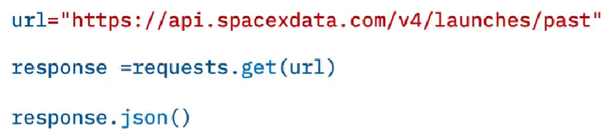
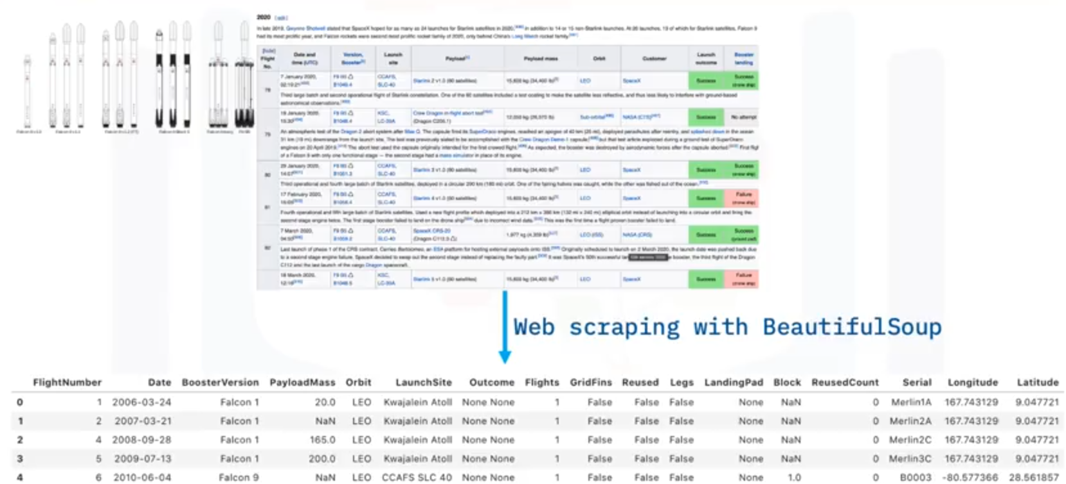
Data Collection
The data was collected in two ways:
gathered from the SpaceX REST API (using the requests library to obtain the launch data and converting the resulting list of JSON objects to a dataframe)
obtained by web scraping related Wiki pages (using the Python BeautifulSoup package to web scrape some HTML tables that contain valuable records and to parse the data from those tables and convert them into a Pandas data frame for further visualization and analysis)
A L E S I A

Slide 8
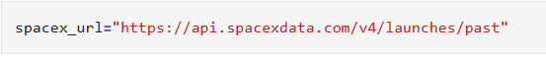
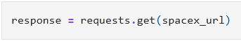
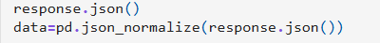
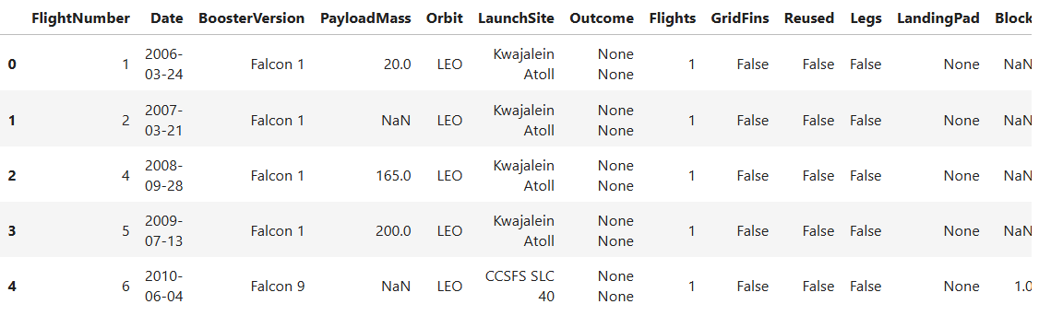
Data Collection – SpaceX API
Rocket launch data was requested from SpaceX Application Programming Interface (API) with Uniform Resource Locator (URL)
The response was viewed by calling the .json() method
The structured json data was “normalized” into a flat table
A L E S I A
Link
to-try/jupyter-labs-spacex-data-collection-api (1).ipynb at main · Alesia-Koo/to-try

Slide 9

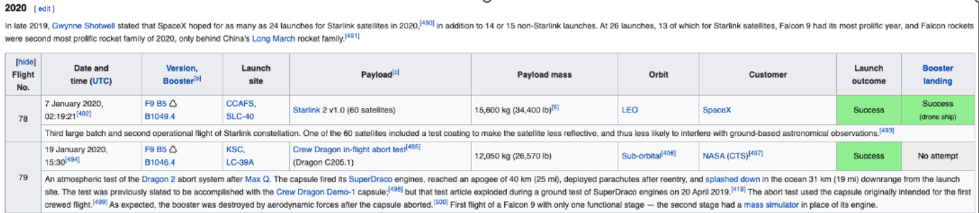
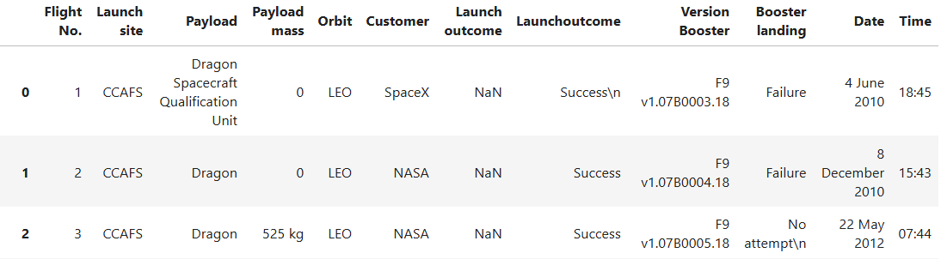
Data Collection - Scraping
The data was extracted from a Wikipedia page and was stored in a HTML table
It was
used GET method to request the data HTML page
and created a BeautufulSoup object from a response text content
after filling in the parsed values into special object it was created a dataframe
A L E S I A
Link
to-try/jupyter-labs-webscraping (2).ipynb at main · Alesia-Koo/to-try

Slide 10
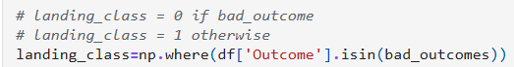
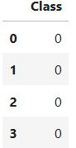
Data Wrangling
The goal was to perform some Exploratory Data Analysis (EDA) to find some patterns in the data and determine classes of landing labeled 1 for the booster landed successfully and 0 for unsuccessfully.
It was
determined the number of landing outcomes on the column OUTCOMES
created a set of outcomes where the first stage did not land successfully
created labels from column OUTCOME
A L E S I A
Link
to-try/labs-jupyter-spacex-Data wrangling.ipynb at main · Alesia-Koo/to-try

Slide 11
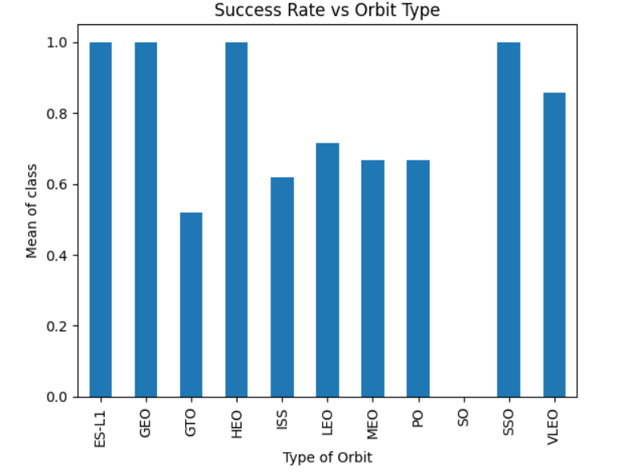
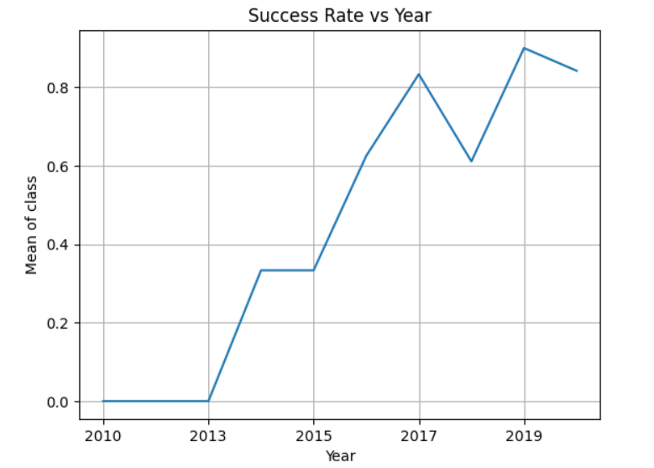
EDA with Data Visualization
An attempt was made to identify variables that directly affect the success of the first stage return. The most suitable for observing the relationship between two variables were scatter and line plots and bar chart.
RESULTS:
A L E S I A
with more massive payloads, the first stage often returns successfully;
as the flight number increases, the first stage is more likely to land successfully;
for the VAFB-SLC launch site there are no rockets launched for heavy payload mass(greater than 10000);
with heavy payloads the successful landing are more for Polar, LEO and ISS;
in the LEO orbit, success seems to be related to the number of flights; in the GTO orbit, there appears to be no relationship between flight number and success.
It was observed that the success rate since 2013 kept increasing till 2020 and
which orbits have the highest success rates.
Link
to-try/edadataviz.ipynb at main · Alesia-Koo/to-try

Slide 12
EDA with SQL
Using SQL queries it was checked information about
the names of the unique launch sites in the space mission;
the total and average payload masses carried by different booster versions;
booster versions which have carried the maximum payload mass;
the date when the first successful landing outcome in ground pad was achieved;
the total number of successful and failure mission outcomes;
various information about the success of the first stage landing at different time intervals.
A L E S I A
Link
to-try/jupyter-labs-eda-sql-coursera_sqllite.ipynb at main · Alesia-Koo/to-try

Slide 13
Build an Interactive Map with Folium
May the launch success rate depend on the location and its proximities?
It was built an interactive map to find some geographical patterns about launch sites.
Using circles, markers, lines and special coordinates on the world map it was marked
all SpaceX launch sites, the success/failed launches for each site and calculated the distances between a launch site to its proximities (such as closest cities, railways, highways).
If a launch was successful (class=1), then it was used a green marker and if a launch was failed, it was used a red marker (class=0)
A launch only happened in one of the four launch sites, which means many launch records have the exact same coordinate. To solve this problem it was used marker clusters.
A L E S I A
Link
to-try/lab_jupyter_launch_site_location (3).ipynb at main · Alesia-Koo/to-try

Slide 14
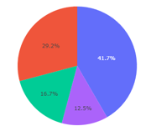
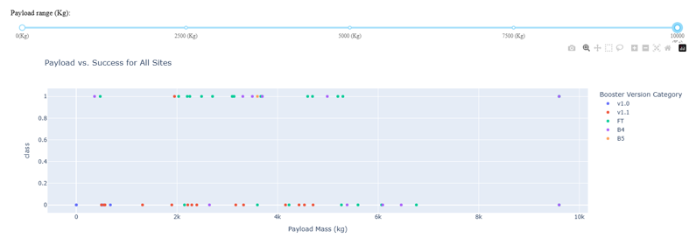
Build a Dashboard with Plotly Dash
A Dashboard was built to perform interactive visual analytics on Spacex launch data in real-time.
It contains a dropdown list and a range slider to interact with charts:
to get the selected launch site and render a pie chart visualizing launch success counts;
to find if variable payload is correlated to mission outcome;
to visually observe how payload may be correlated with mission outcomes for selected site(s) and with different boosters.
A L E S I A
Link
to-try/spacex-dash-app (3).py at main · Alesia-Koo/to-try

Slide 15
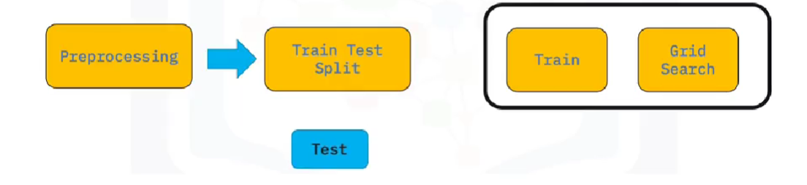
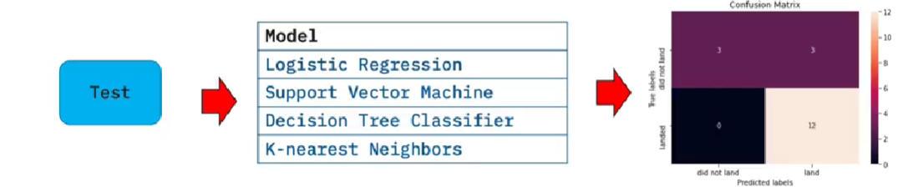
Predictive Analysis (Classification)
The goal of Classification was to predict the landing success of first stage.
Milestones:
A L E S I A
to build a Machine Learning Pipeline for prediction
to determine Model with the Best Accuracy
Link
to-try/SpaceX_Machine Learning Prediction_Part_5 (2).ipynb at main · Alesia-Koo/to-try

Slide 16
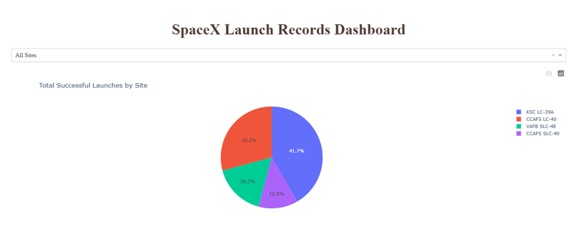
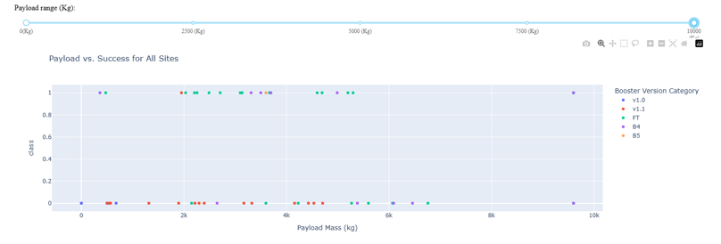
Results
The first stage often returns successfully with more massive payloads, as the flight number increases, with heavy payloads are more for Polar, LEO and ISS. The success rate since 2013 kept increasing till 2020. ES-L1, GEO, HEO and SSO types of orbits have the highest success rates. The total number of successful mission outcomes significantly exceed the number of failure missions.
A L E S I A
The accuracy of all models from Machine Learning (Logistic Regression, Support Vector machines, Decision Tree Classifier, and K-nearest neighbors) on the test data has approximately the same result (0.833-0.875)

Slide 17

Section 2

Slide 18
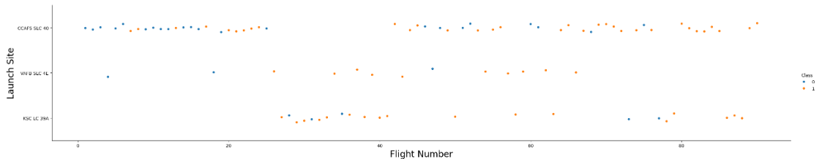
Flight Number vs. Launch Site
A L E S I A
As the flight number increases, the first stage is more likely to land successfully.
The largest number of launches were made from the site CCAFS SLC-40. There have been many successful and many failed missions here.
Least number of launches were made from the site VAFB-SLC. Most missions were successful.

Slide 19
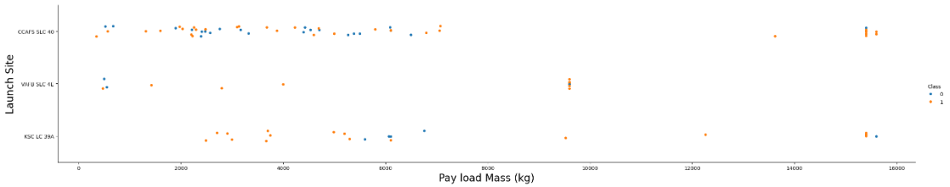
Payload vs. Launch Site
A L E S I A
For the VAFB-SLC launch site there are no rockets launched for heavy payload mass (greater than 10000).
The most successful launches for the site KSC LC-39A were those with smaller payload mass.

Slide 20
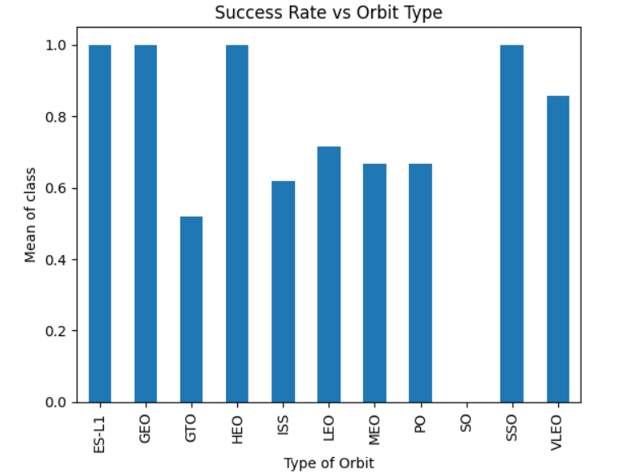
Success Rate vs. Orbit Type
ES-L1, GEO, HEO and SSO types of orbits have the highest success rates.
There were no successful launches into the SO orbit type.
A L E S I A

Slide 21
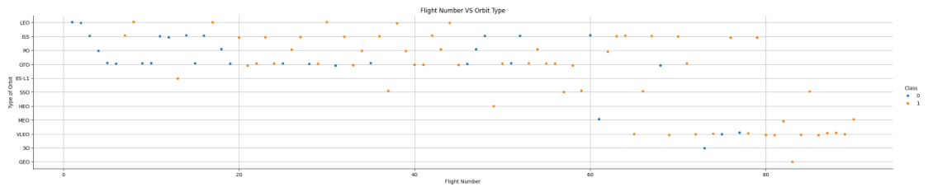
Flight Number vs. Orbit Type
A L E S I A
In the LEO orbit, success seems to be related to the number of flights.
In the GTO orbit, there appears to be no relationship between flight number and success.
There are only successful launches in the orbit SSO.

Slide 22
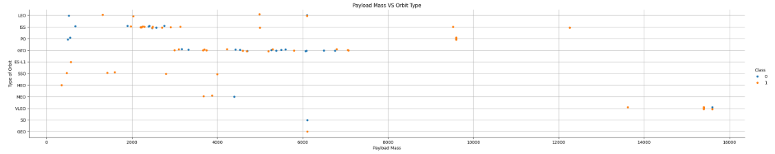
Payload vs. Orbit Type
A L E S I A
With heavy payloads the successful landing are more for Polar, LEO and ISS orbits.
For the GTO orbit, it's difficult to distinguish between successful and unsuccessful landings as both outcomes are present.

Slide 23
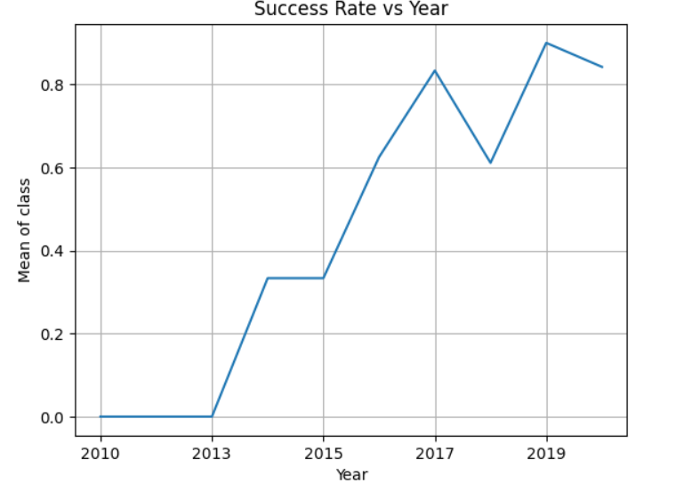
Launch Success Yearly Trend
The success rate since 2013 kept increasing till 2020.
A L E S I A

Slide 24
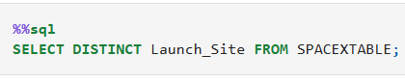
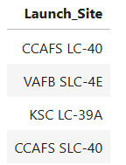
All Launch Site Names
A L E S I A
There are only four unique names of launch sites of Space X

Slide 25
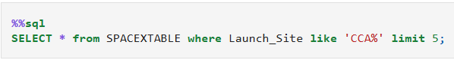
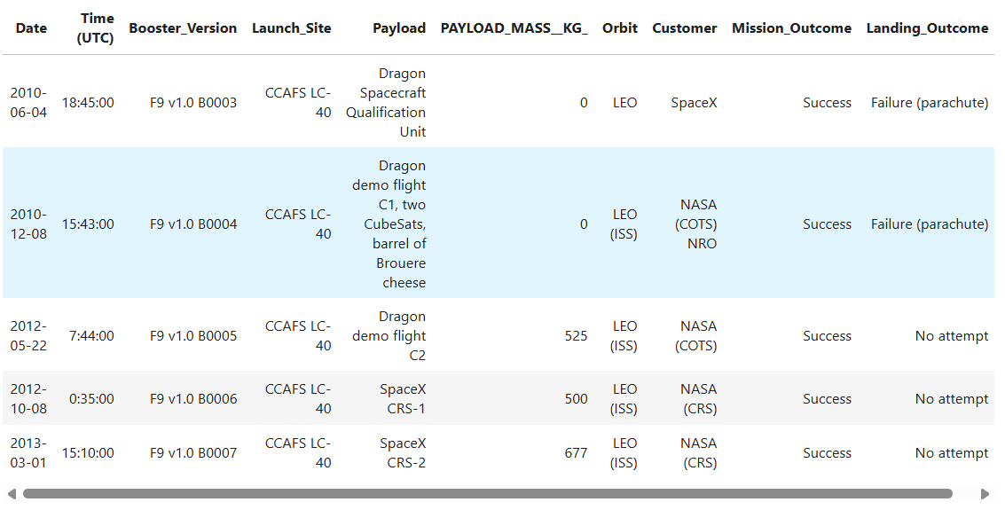
Launch Site Names Begin with 'CCA'
A L E S I A
All of this launches were in the same orbit and had successful mission outcomes.

Slide 26
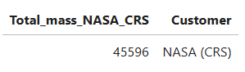
Total Payload Mass
A L E S I A
This result is for NASA (CRS) customer only.

Slide 27
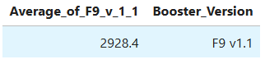
Average Payload Mass by F9 v1.1
A L E S I A
This result is for Booster version F9 v1.1 only.

Slide 28
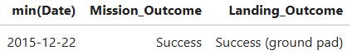
First Successful Ground Landing Date
A L E S I A
The first successful landing outcome in ground pad was achieved on December 22, 2015.

Slide 29
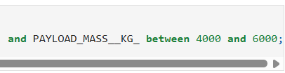
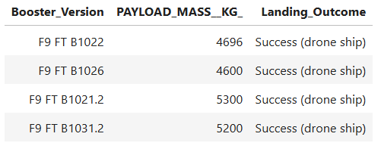
Successful Drone Ship Landing with Payload between 4000 and 6000
A L E S I A
The names of the boosters which have success in drone ship and have payload mass greater than 4000 but less than 6000

Slide 30

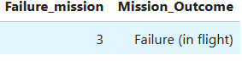
Total Number of Successful and Failure Mission Outcomes
A L E S I A
The vast majority of missions were successful.

Slide 31
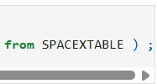
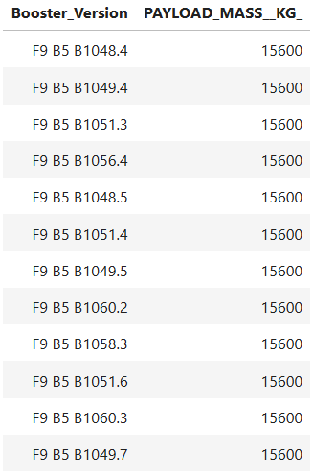
Boosters Carried Maximum Payload
A L E S I A
The names of the booster versions which have carried the maximum payload mass.

Slide 32
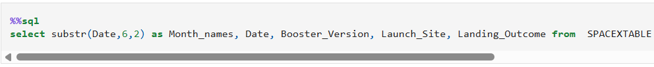
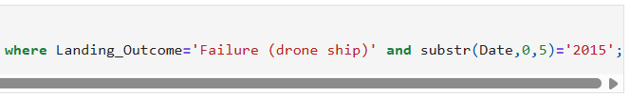
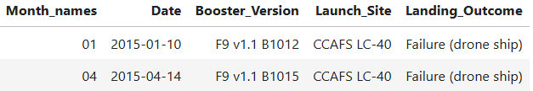
2015 Launch Records
A L E S I A
The failed landing outcomes in drone ship, their booster versions, and launch site names for in year 2015

Slide 33
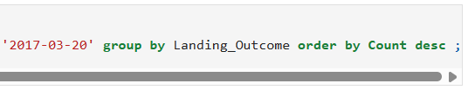
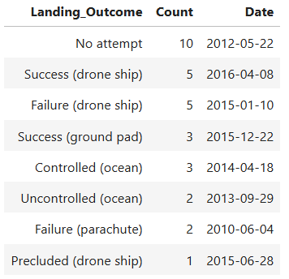
Rank Landing Outcomes Between 2010-06-04 and 2017-03-20
A L E S I A
The count of landing outcomes between the date
2010-06-04 and 2017-03-20, in descending order

Slide 34

Section 3

Slide 35
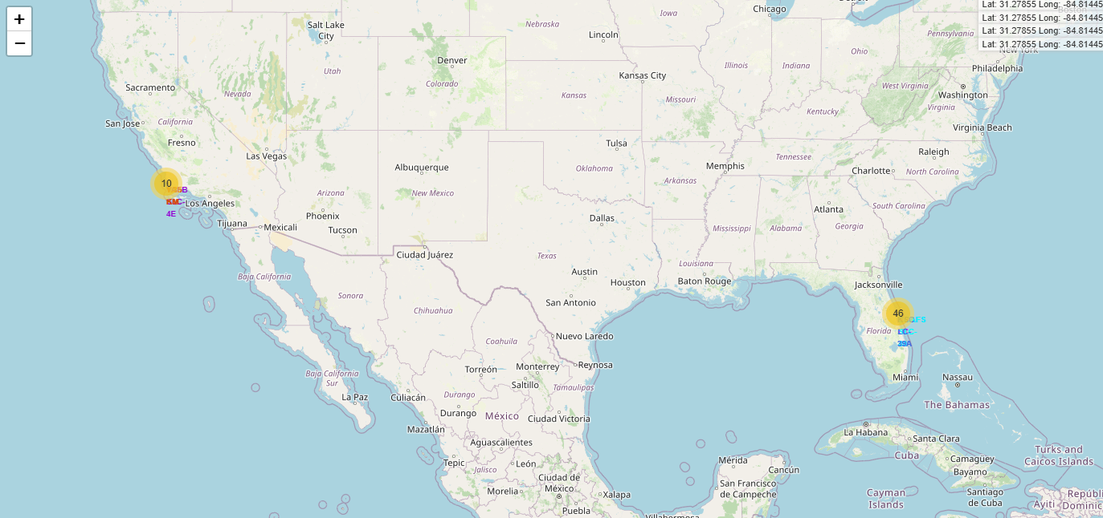
Space X launch sites on a map
A L E S I A
All launch sites are in very close proximity to the ocean coast and to the Equator line.

Slide 36
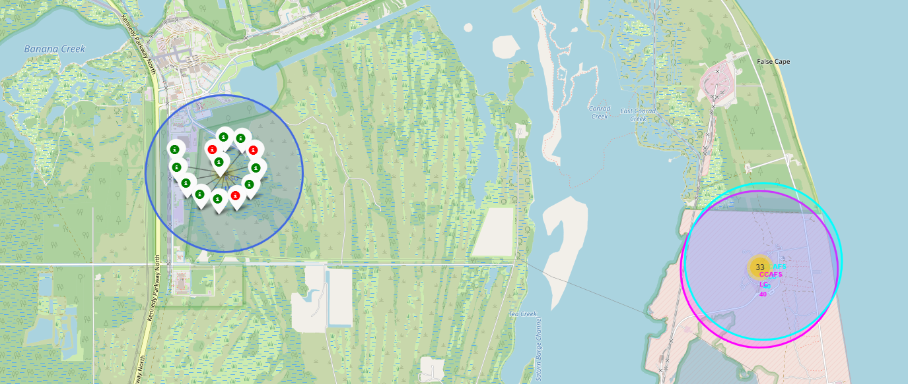
Launch outcomes for each site
A L E S I A
It was created markers for all launch records.
If a launch was successful, it was used a green marker and if a launch was failed, it was used a red marker.

Slide 37
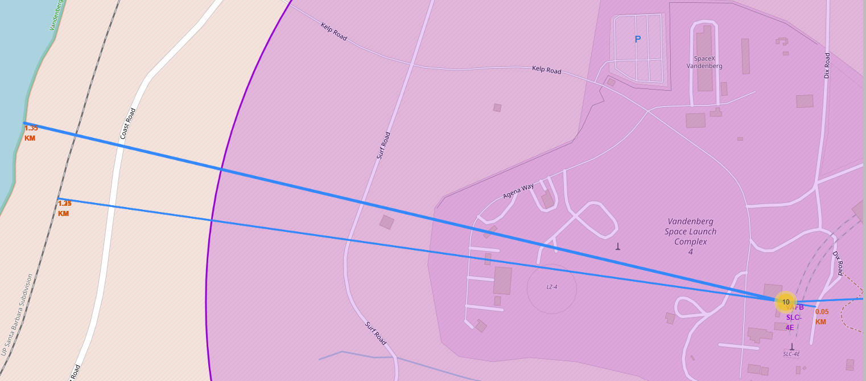
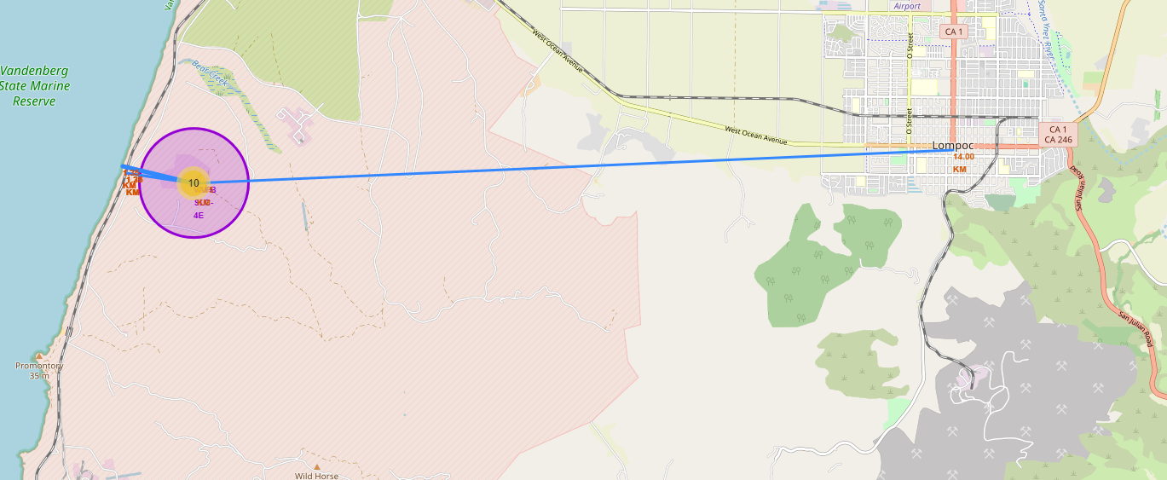
The proximities of launch sites
A L E S I A
Launch sites are in close proximity to railways, highways and coastline.
Launch sites keep certain distance away from cities.

Slide 38

Section 4

Slide 39
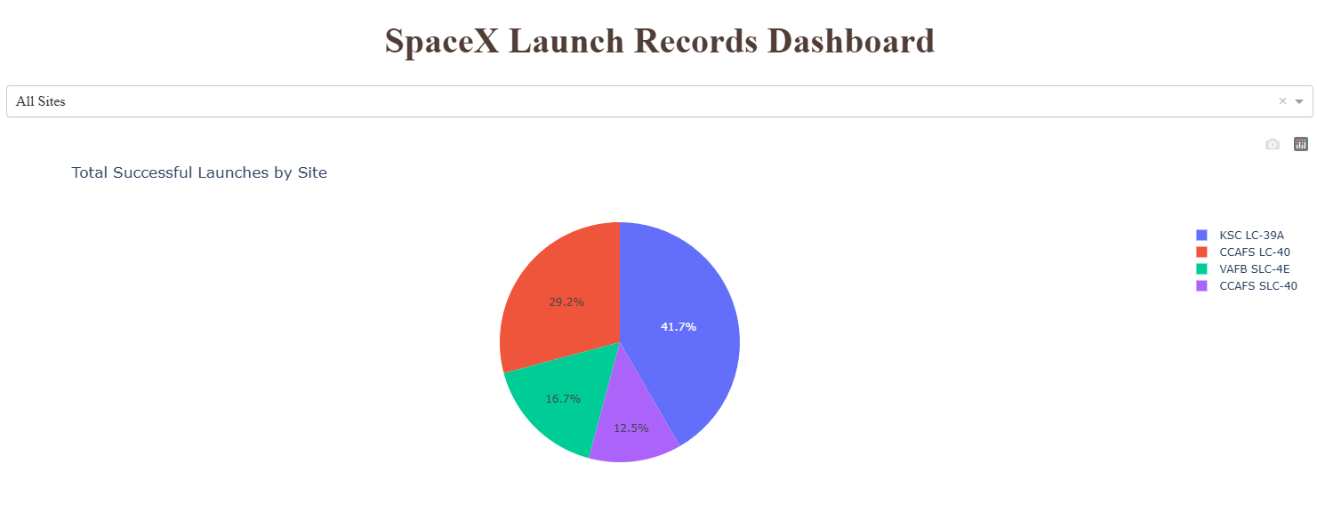
Total successful launches by site
A L E S I A
KSC LC-39A launch site has the highest success rate.

Slide 40
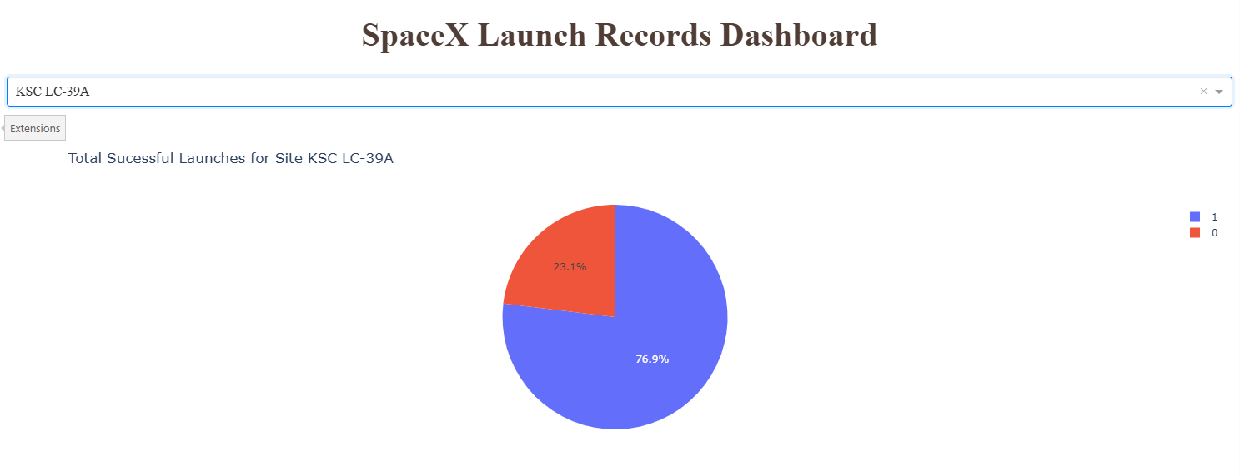
Launch site with the highest success rate
A L E S I A
KSC LC-39A launch site has the highest launch success rate.

Slide 41
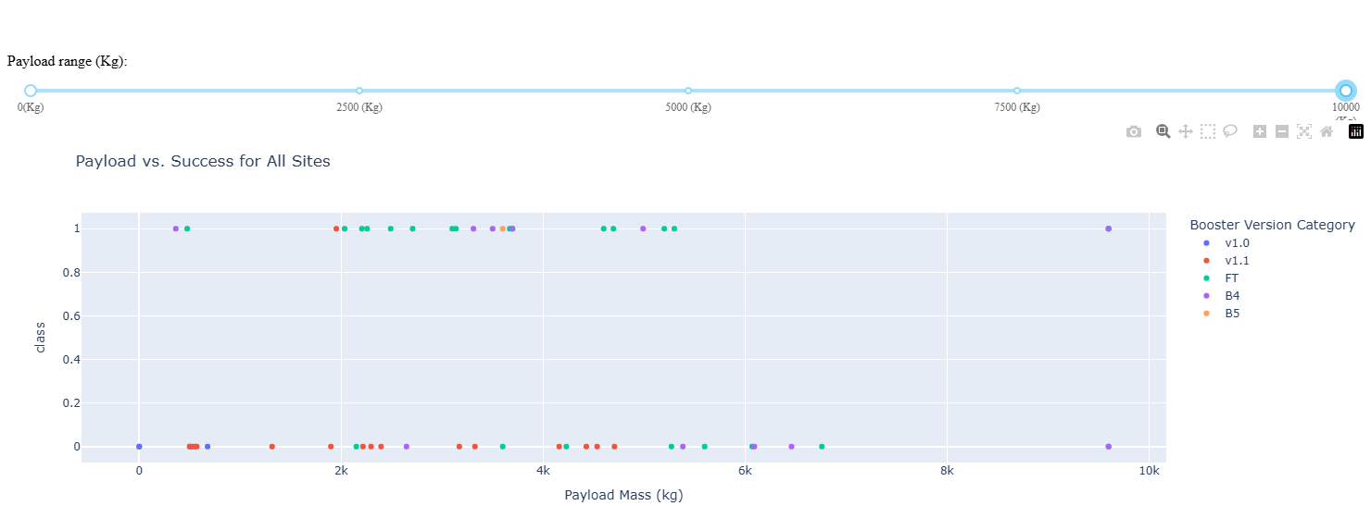
Payload vs. Launch outcome
A L E S I A
FT booster version and payload mass between 2000 and 4000 kg have the largest success rate.

Slide 42

Section 5

Slide 43

Classification Accuracy
All models have the same classification accuracy
A L E S I A

Slide 44

Confusion Matrix
All models have the same classification accuracy.
Therefore, the confusion matrices are the same.
A L E S I A

Slide 45
Conclusions
There are only four unique names of launch sites of Space X.
All launch sites are in very close proximity to the ocean coast and to the Equator line, railways, highways and coastline and keep certain distance away from cities.
The total number of successful mission outcomes significantly exceed the number of failure missions.
KSC LC-39A launch site, rocket configuration Falcon 9 FT and payload mass between 2000 and 4000 kg have the highest success rate.
.The largest number of launches were made from the site CCAFS SLC-40. There have been many successful and many failed missions here.
Least number of launches were made from the site VAFB-SLC. Most missions were successful.
The first stage often returns successfully with more massive payloads, as the flight number increases, with heavy payloads are more for Polar, LEO and ISS.
ES-L1, GEO, HEO and SSO types of orbits have the highest success rates.
All predictive models have the same classification accuracy.
A L E S I A

Slide 46

Appendix
Links
DASH – Cloud IDE
https://theiadockernext-1-labs-prod-theiak8s-4-tor01.labs.cognitiveclass.ai/user/alesyakooche/#
https://theiadockernext-1-labs-prod-theiak8s-4-tor01.labs.cognitiveclass.ai/user/alesyakooche/#
https://theiadockernext-1-labs-prod-theiak8s-4-tor01.labs.cognitiveclass.ai/user/alesyakooche/#
Trust Notebook
View-Activate Command Palette-Trust Notebook
https://api.spacexdata.com/v4/launches/past
https://cf-courses-data.s3.us.cloud-object-storage.appdomain.cloud/IBM-DS0321EN-SkillsNetwork/datasets/API_call_spacex_api.json
https://en.wikipedia.org/wiki/List_of_Falcon_9_and_Falcon_Heavy_launches
https://en.wikipedia.org/w/index.php?title=List_of_Falcon_9_and_Falcon_Heavy_launches&oldid=1027686922
https://cf-courses-data.s3.us.cloud-object-storage.appdomain.cloud/IBM-DS0321EN-SkillsNetwork/datasets/dataset_part_1.csv
https://cf-courses-data.s3.us.cloud-object-storage.appdomain.cloud/IBM-DS0321EN-SkillsNetwork/datasets/dataset_part_2.csv
https://cf-courses-data.s3.us.cloud-object-storage.appdomain.cloud/IBM-DS0321EN-SkillsNetwork/labs/module_2/data/Spacex.csv
https://cf-courses-data.s3.us.cloud-object-storage.appdomain.cloud/IBM-DS0321EN-SkillsNetwork/labs/module_2/data/Spacex.csv
https://cf-courses-data.s3.us.cloud-object-storage.appdomain.cloud/IBMDeveloperSkillsNetwork-DV0101EN-SkillsNetwork/labs/v4/DV0101EN-Exercise-Generating-Maps-in-Python.ipynb
https://cf-courses-data.s3.us.cloud-object-storage.appdomain.cloud/IBM-DS0321EN-SkillsNetwork/datasets/spacex_launch_geo.csv
https://cf-courses-data.s3.us.cloud-object-storage.appdomain.cloud/IBM-DS0321EN-SkillsNetwork/datasets/dataset_part_2.csv
https://cf-courses-data.s3.us.cloud-object-storage.appdomain.cloud/IBM-DS0321EN-SkillsNetwork/datasets/dataset_part_3.csv
https://cf-courses-data.s3.us.cloud-object-storage.appdomain.cloud/IBM-DS0321EN-SkillsNetwork/datasets/spacex_launch_dash.csv
https://cf-courses-data.s3.us.cloud-object-storage.appdomain.cloud/t4-Vy4iOU19i8y6E3Px_ww/spacex-dash-app.py
https://dash.plotly.com/dash-core-components/dropdown
https://dash.plotly.com/dash-core-components/rangeslider
https://plotly.com/python/pie-charts/
https://plotly.com/python/line-and-scatter/
A L E S I A
LABS
Hands-on Lab : String Patterns, Sorting and Grouping
Hands-on Lab: Built-in functions
Hands-on Lab : Sub-queries and Nested SELECT Statements
Hands-on Tutorial: Accessing Databases with SQL magic
Hands-on Lab: Analyzing a real World Data Set

Slide 47


